Slide 1
JULY
2018
Integration of GBV into HIV/STI services increases uptake of post-GBV care services among Key Populations
Lessons learned from Papua New Guinea, 2015 - 2017
DR. IGNATIUS ULAH MOGABA
FHI 360, Papua New Guinea
#AIDS2018 | @AIDS_conference | www.aids2018.org

Slide 2
BACKGROUND
7.8 million
Papua New Guineans
0.9% HIV prevalence (UNAIDS)
14.9% FSW (NDoH)
8.5% MSM/TG (NDoH)
2/3
women
(Darko et al.)
41–45% FSW & MSM/TG (Kelly-Hanku) experience GBV
GBV increases HIV risk yet decreases service utilization.
Sociocultural factors inhibit GBV disclosure and service uptake
FHI360/USAID project is integrating GBV and HIV/STI services
Notes:
Papua New Guinea is the most populous island in Western pacific.
The overall HIV prevalence in the country is under 1%, but is as high as 1.68% in some geographic locations.
The prevalence is much higher in key populations.
As many as 2/3 of women in Papua New Guinea experience gender-based violence (GBV) and as high as 41% - 45% of key populations reported sexual violence in the last 12 months.
We know that GBV does not only increase risk of HIV, but also decrease utilization of HIV services.

Slide 3
FHI 360’s KP Project Overview
Title Strengthening HIV/AIDS Services for Key Populations in PNG
Donor United States Agency for International Development (USAID)
Objectives
Increase demand for HIV/AIDS services
Increase the supply of quality HIV/AIDS services
Increase the use of facility-and community-based gender and GBV interventions
Strengthen health systems for HIV/AIDS service delivery.
Notes:
FHI 360 is implementing a project known as ‘Strengthening HIV/AIDS Services for Key Populations in PNG’. This project is funded by PEPFAR through USAID and targets FSW, MSM and transgender women
One of the objectives of the project is to increase KP’s access to health facility and community based gender and GBV services.

Slide 4
DESCRIPTION
1
2
Project is increasing KP’s access to GBV related services
Integrating gender/GBV interventions into HIV/STI services started in 2015
Key interventions included
Preparing service providers for KP-friendly, comprehensive post-GBV clinical services
Increasing awareness on GBV among target populations
Strengthening prevention and referral linkages for relevant services
Notes:
Prior to our interventions, post-GBV clinical care was only offered by special clinics known as Family Support Centres (FSC). There is only one FSC in any given province and not all provinces have an FSC. Secondly, the FSCs were primarily concerned with family based violence and were not particularly accessible to key populations.
We thought that one way to increase access to post-GBV care, especially for key populations is to integrate GBV services into existing HIV and STI services in the health facilities.
Our integration effort started in 2015.
Initial interventions were focused on preparing service providers in health facilities to offer KP-friendly and comprehensive post-GBV clinical services.
Then we moved to raising awareness among KP, communities and other service providers, and then to strengthening referral linkages between the community and health facilities and with other services such as shelter, law enforcement, legal etc.

Slide 5
KEY INTERVENTIONS
Objective | Activities
Prepare service providers for KP-friendly, comprehensive post-GBV clinical services | Clinic readiness assessment Equipped clinics to provide minimum 5 essential post-GBV services Sensitize service providers on sexual diversity and KPs Trainings on GBV screening protocol, post-care and documentation
Increase awareness on GBV among target populations | Sensitization/gender norms trainings for community leaders/workers & HCW Awareness on the relationship between GBV/HIV, vulnerability of KP to GBV
Strengthen prevention and referral linkages for relevant services | Trained outreach workers on GBV SOP and safety planning Orientation for phone counsellors and distribution of information cards
Notes:
what exactly did we do?
We focused our intervention in the 5 health facilities supported by the project and the communities within their catchment areas.
This table highlights key activities that we implemented under each component of our interventions.
We began with health clinic readiness assessments and worked with the clinics to address the gaps and equipped them to provide the 5 essential post-GBV services for sexual violence (psychological first aid, PICT, PEP, STI prophylaxis and oral contraception).
Preparing HIV/STI service providers to offer post-GBV care was relatively easy since there is a significant overlap between the skill set required to provide post-GBV clinical care and STI/HIV services. That meant we didn’t have to re-train service providers PEP, PICT, STI services, etc., but instead trained them on the application of the GBV screening protocol, provision of psychological first aid, sexual diversity and KP sensitization, and documentation of services.
Our programming included;
Outreach and awareness raising on GBV and location of post-GBV services
Training peer outreach workers to educate KPs on the relationship between GBV/HIV, their vulnerability to GBV, and the rights of all to live free from GBV.
Working with community workers (peer educators and phone counsellors) to establish referral pathways to link survivors between services.

Slide 6
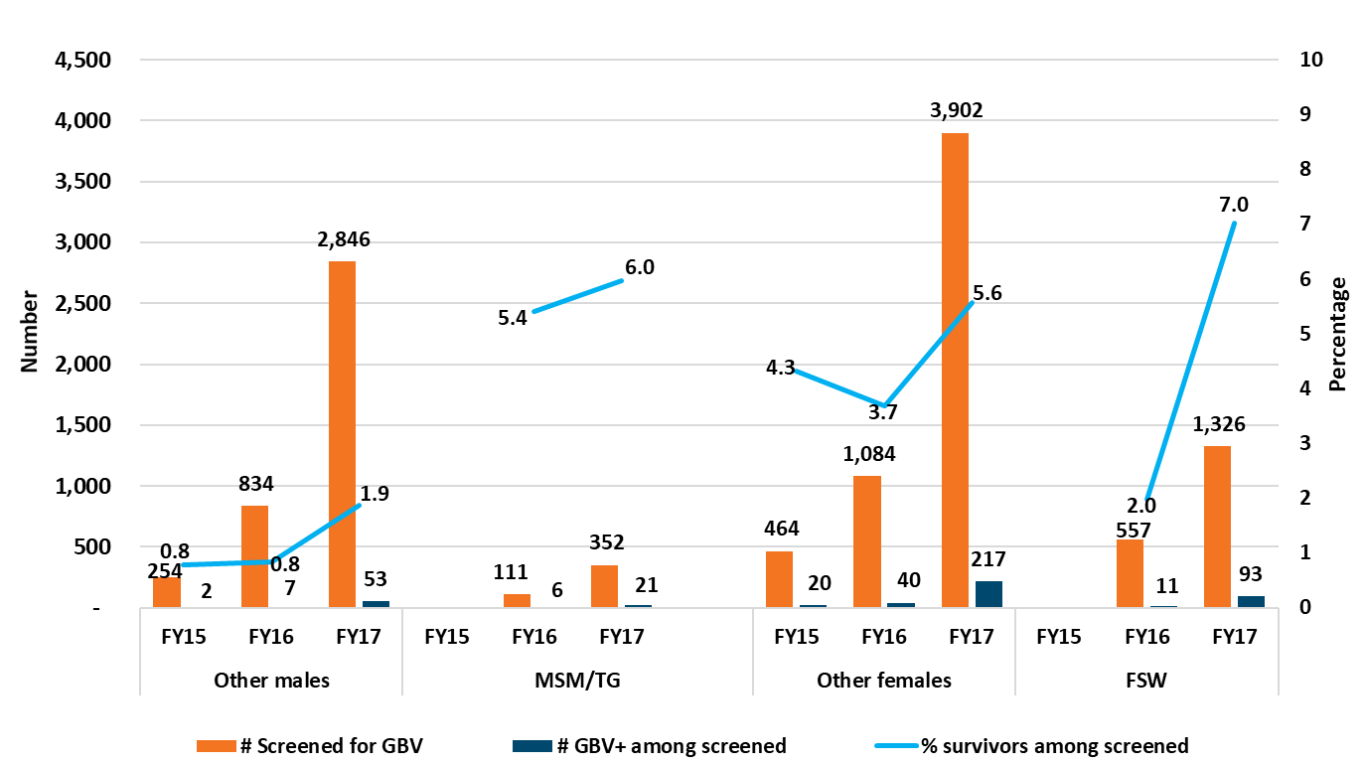
ROUTINE SCREENING OUTCOME
Notes:
This chart provides a trend analysis on the outcome of routine GBV screening in the 5 health facilities looking at number of individuals screened for GBV among clients accessing HIV/STI services and those identified as GBV-survivors. The blue line represent and proportion of GBV survivors among those screened.
Unfortunately, disaggregated data by KP was not available until FY 2016. So, data for FY 15 is inclusive of all populations.
Not all clients were screened.

Slide 7
LESSONS FROM ROUTINE SCREENING
1
2
3
Increased GBV-screened individuals among clients accessing HIV/STI services
% of individuals identified as GBV-survivors remained low
Higher increase in % identified as GBV-survivors among FSWs
Notes:
With integration, the number of GBV-screened individuals among clients accessing HIV/STI services increased significantly from 718 (2015) to 8,426 (2017).
The percentage of individuals screened and identified as GBV-survivors increased only marginally.
However, there was a dramatic increase in the percentage of FSW screened who were identified as GBV survivors from 2% in 2016 to 7% in 2017.
We believe that there are many more people who suffer GBV but do not disclose, due to multiple socio-cultural factors.
However, during this intervention we were not able to define these factors.

Slide 8
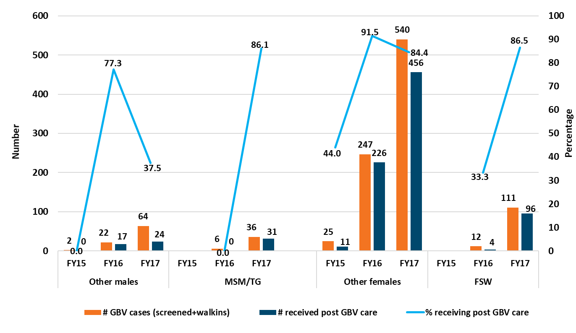
UPTAKE OF POST-GBV CARE
Notes:
This one show trend in the number of GBV-survivors seen (including the walks-ins and referrals from the community) and the those who received the appropriate post-GBV care among them. The line in this case measures the proportion.
At the later part of FY 2017 the Provincial Government decide merge two of the clinics following the closure one. It took while for the two set of staff reassign roles and responsibilities and this affected the quality of documentation. This explains the dips in percentage of male and female survivors who received post GBV care in FY 2017.

Slide 9
LESSONS FROM POST-GBV CARE
Increase in % of survivors seen receiving post-GBV care.
Increase was more among KPs
MSM/TG: 0% (2015) to 86.1%, (2017)
FSW: 33.3% (2015) to 86.5% (2015) .
1
2
Notes:
The number of GBV cases (including walk-ins) increased exponentially.
The percentage of survivors seen (including walk-ins/referrals) receiving post-GBV care for both sexes increased sharply before a 2017 decline.
The percentage of GBV survivors among KPs who received care increased sharply (2015-2017) (MSM/TG: 0% to 86.1%, FSW: 33.3% to 86.5%).
This intervention demonstrates that when the services are integrated, more GBV survivors are reached with post-GBV care since it because possible for survivors to access essential service in one location.

Slide 10
CONCLUSIONS
1
Integration of GBV with HIV/STI services is feasible
Approach increases uptake of post-GBV care
Proactive screening alone is insufficient as multiple factors affect GBV survivors’ disclosure
A combination of approaches is needed
2
3
4
Notes:
Our experience demonstrates that it is possible to integrate GBV and HIV/STI services.
In this context, increasing the number of service points, providing integrated KP-friendly and comprehensive GBV services combined with community GBV awareness and referrals had a dramatic impact on the uptake of post-GBV care. GBV survivors now had alternative access to post-GBV care in the 5 health facilities that offered this integrated approach.
However, integration is only one of the ways we can increase access to GBV services.
We note that proactive screening alone is insufficient for identifying GBV cases.
Because multiple factors affect disclosure among GBV survivors, a combination of approaches is required.
The approaches that worked in our case were:
Integrating GBV services into our peer outreach program for KPs, and
Integrating the clinical component into HIV testing, STI management and HIV care and treatment.

Slide 11
NEXT STEPS
Scale to health facilities with limited donor support.
Enquiry into factors affecting GBV survivors’ disclosure.
Notes:
The 5 health facilities that were involved in this initial phase of integration are benefitting from some level human resource support from the project.
FHI 360 is now working with the provincial government to scale this approach to other health facilities that do not have human resource support. Initial experience with 3 of such health facilities also shows promising results.
Low GBV case finding from routine screening merits scientific enquiry to better understand factors affecting disclosure. Anecdotal data suggest an interplay of multiple social-cultural factors. Understanding these factors will be helpful in designing appropriate interventions that can improve screening outcomes.
Understanding these factors will also help us determine if a single or a less multi-faceted approach would improve identification and service uptake and hence be more cost efficient.
Low GBV case finding from routine screening merits scientific enquiry to better understand factors affecting disclosure. Anecdotal data suggest an interplay of multiple social-cultural factors. Understanding these factors will be helpful in designing appropriate interventions that can improve screening outcomes.
Understanding these factors will also help us determine if a single or a less multi-faceted approach would improve identification and service uptake and hence be more cost efficient.

Slide 12
Acknowledgement
Notes:
We acknowledge the support of PEPFAR through USAID, and the partnership with the Papua New Guinea National AIDS Council, National Department of Health, and National Capital District Health Services in rolling out the integration.

Slide 13
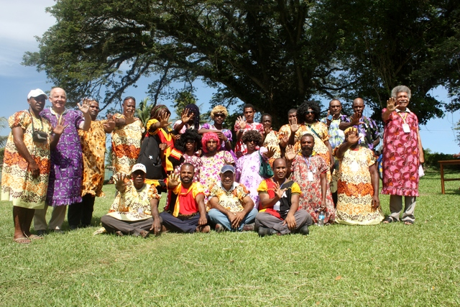
THANK YOU
Be ‘Men of honour’. Stop the violence in your homes.
Photograph: Ryan Brown/UN Women/UN Press Office
Notes:
I would like to end with this lovely picture of PNG men in meri blouses and raising their hands to say no to GBV. Meri-blouses is a traditional wear for women.
The picture was taken as part of the 16 days of activism to end violence against women.
Now we are saying to these men, it isn’t enough to wear meri-blouses, be ‘Men of Honor’ by stopping the violence their homes and communities.
Thank you.

